Slide 1
Normal cryogenic fluid behavior (with emphasis on helium)
Ram C. Dhuley (updates by Greg Tatkowski)
USPAS – Cryogenic Engineering
February 3 – February 7, 2025

Slide 2
Goals of this lecture
Familiarize with different types of flow and heat transfer modes in large scale helium cryogenics
Learn engineering design parameters of cryogenic helium systems
  Here we will focus only on normal helium
  Superfluid helium and its properties will be covered in another lecture.
Briefly look at other common cryogens – nitrogen, argon

Slide 3
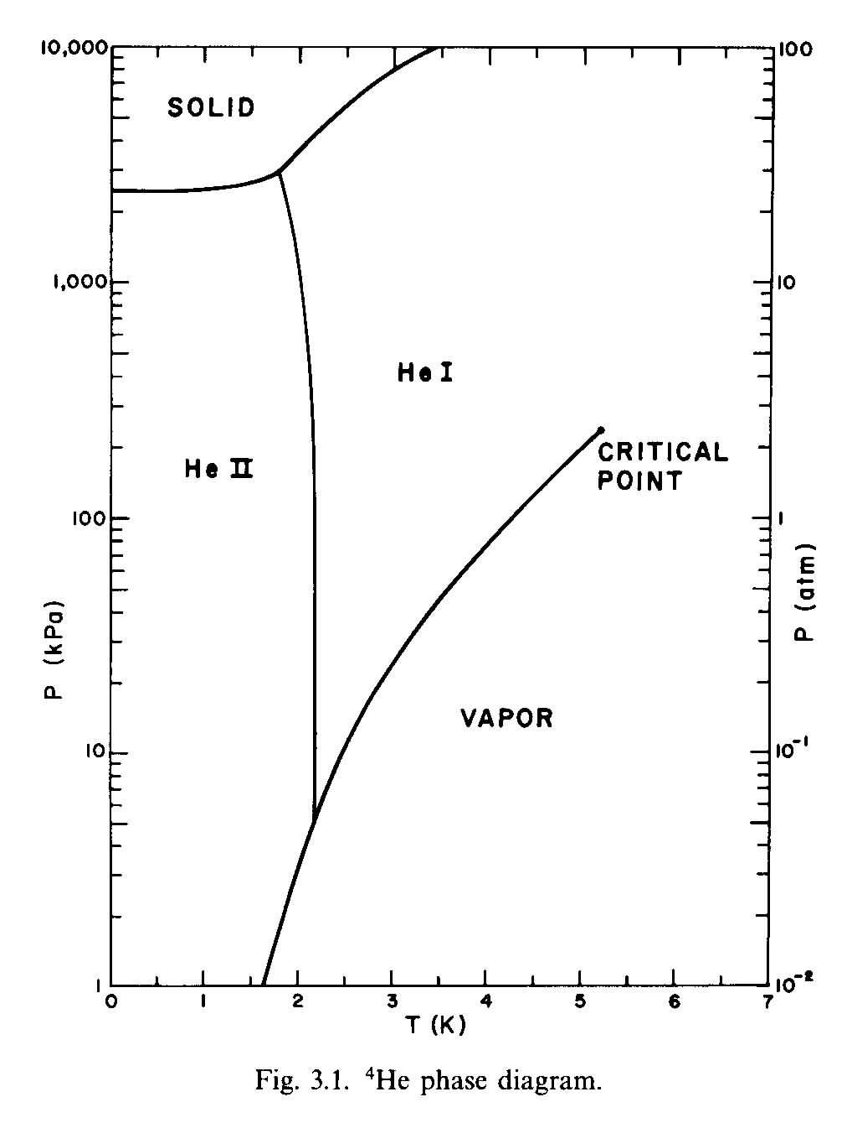
Phase diagram of helium
Supercritical He
Pressurized He I (liquid)
Pressurized He II (liquid)
Saturated He I
He vapor
Saturated He II
S. W. Van Sciver, Helium Cryogenics (2012), pg. 60

Slide 4
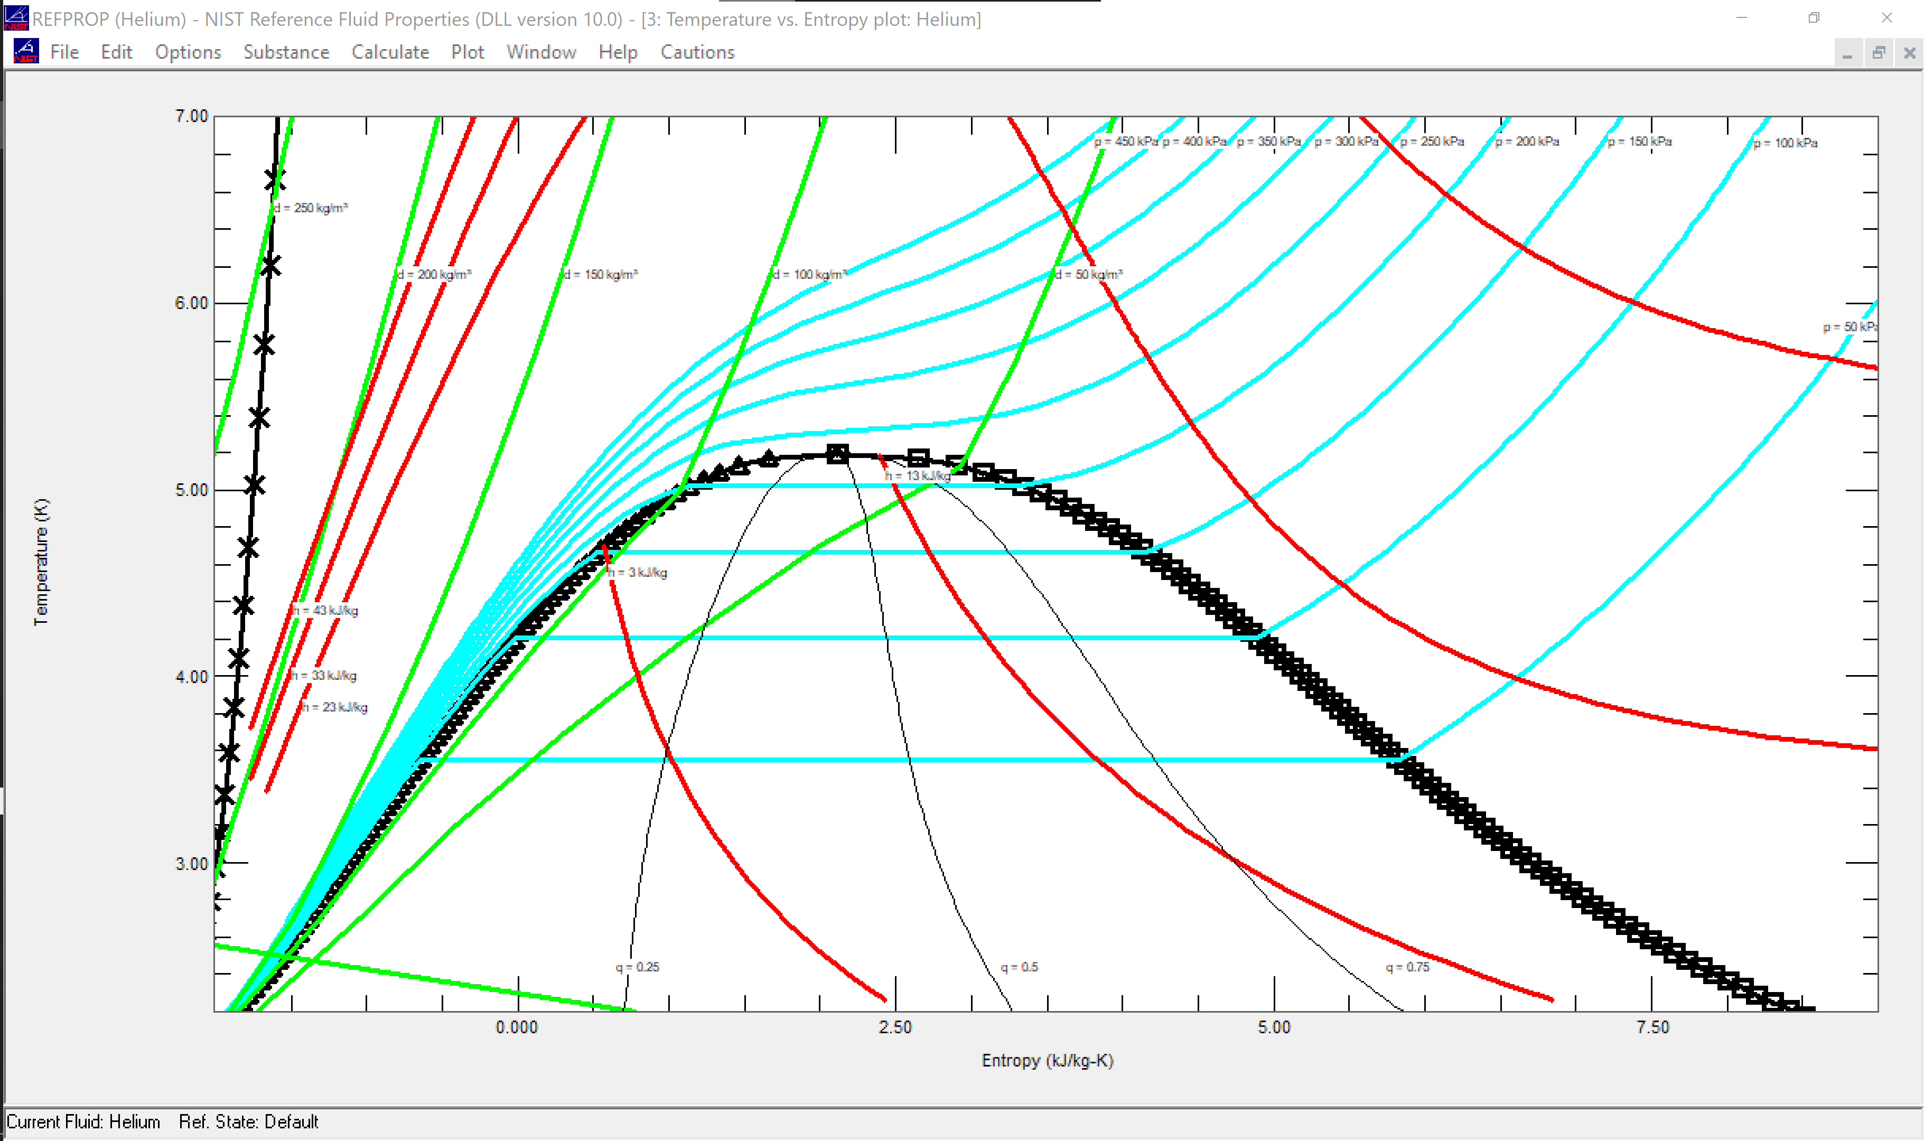
Temperature Entropy Diagram ⁴He

Slide 5
Cooling modes in large helium cryogenic systems
Accelerator magnets are often cooled with pressurized liquid or forced flow of supercritical helium
gives maximum penetration of helium mass in magnet coils
crucial for thermal stability since the coils operate near the superconductivity limit
SSC
Tevatron
LHC

Slide 6
Cooling modes in large helium cryogenic systems
Superconducting RF cavities are generally cooled with a saturated helium bath (normal or superfluid)
gives pressure stability needed to minimize cavity de-tune
offers large surface heat transfer for local hot spots
provides nearly isothermal cooling
HERA, KEKB
ESS, LCLS-II, PIP-II

Slide 7
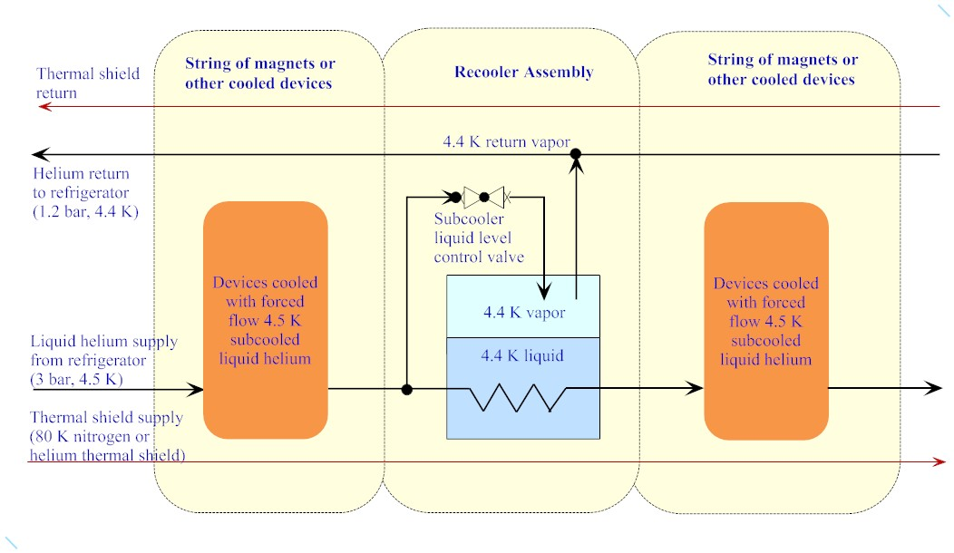
Helium cooling modes - examples
Re-cooler scheme for accelerator SC magnets. Modes present:
  Subcooled liquid helium flow
  Convection/nucleate boiling heat transfer
  Single phase vapor flow
3
2
1

Slide 8
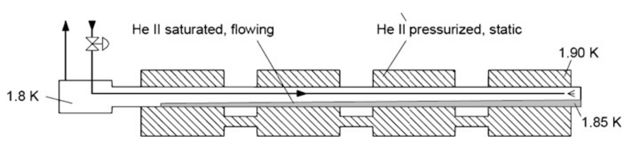
Helium cooling modes - examples
Bayonet heat exchangers for LHC superconducting
magnets. Modes present:
  Two phase He II flow
  Single phase vapor flow
  Surface heat transfer to He II (Kapitza mode)
2
1
Magnet
3
Magnet
Magnet
Magnet

Slide 9
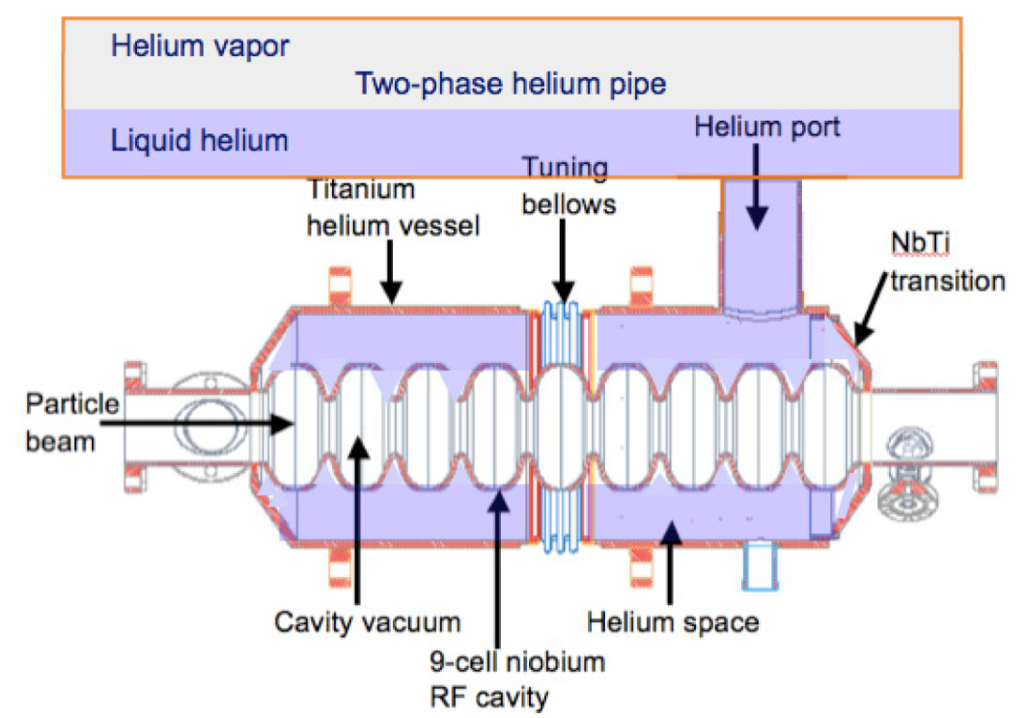
Helium cooling modes - examples
Saturated helium bath cooling of superconducting radiofrequency accelerator cavities
1
Modes present:
Single phase vapor flow
Two-phase flow (during bath fill)
Surface heat transfer
(Kapitza or nucleate
boiling)
3
2
Fill line

Slide 10
Helium cooling modes - examples
Distribution of cryogenic helium. Modes present:
  Supercritical helium flow
  Two phase flow
  Single phase vapor flow
  Heat transfer (heat leak)
4
JT valve
Helium cryoplant
1
2
SC device
being cooled
3
Supply and return pipelines
(can be very long, several 100 m)

Slide 11
Helium cooling modes - summary
As seen in the prior examples, a large-scale helium cryogenic system will typically
involve several flow and heat transfer modes
operating in parallel
What are the engineering parameters one should know to be able to design such helium cryosystems?

Slide 12
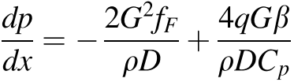
Engineering design parameters
Compressor/pump power required for circulating helium depends on the pressure drop in the circuit:
Expression assumes helium behaves as
ideal gas and has small flow velocity.
(See Helium Cryogenics chapter 4 for details)
Friction factor, f_{F} determines the frictional pressure drop:
Type of flow – single phase, two-phase
Flow regime – laminar, turbulent, mixed
Heat leak, q determines the acceleration pressure drop:
Relevant to compressible (gas/supercritical) and two-phase flows

Slide 13
Engineering design parameters
Superconducting device stability/performance depends on the effectiveness of heat transfer to the helium coolant:
Heat transfer coefficient, h_{c} determines the effectiveness of heat transfer from the load to the fluid
Mode of heat transfer – forced, natural convection, pool boiling
Flow regime/type – laminar, turbulent, single/two-phase
Boiling regime – nucleate, film

Slide 14
Relevant dimensionless parameters
Reynolds number:
Ratio of inertia to viscosity:
where ρ is density, v is velocity, D is a characteristic
dimension, and µ is dynamic viscosity
Prandtl number:
Viscous/thermal diffusion:
where k_{f} and c_{p} are is fluid thermal conductivity and
heat capacity
Grashof number:
Buoyancy/viscous force:
where β is thermal expansivity, T_{s} and T_{f} are surface
and fluid temperatures, L is a characteristic dimension,
and v is kinematic viscosity

Slide 15
Relevant dimensionless parameters
Friction factor:
Required for calculating pressure drop in a channel with forced flow
Nusselt number:
For forced convection:
For natural convection:
Required for calculating convective heat transfer coefficient, h

Slide 16
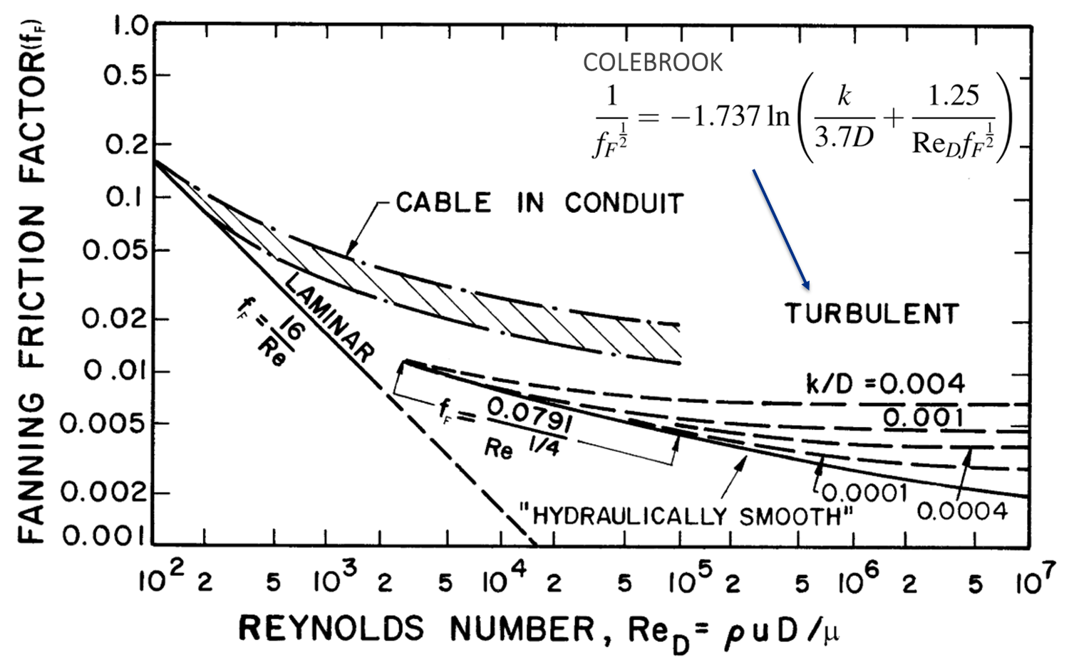
Pressure drop in forced flow (single phase)
Friction factors: correlations and Moody chart
S. W. Van Sciver, Helium Cryogenics (2012), pg. 90

Slide 17
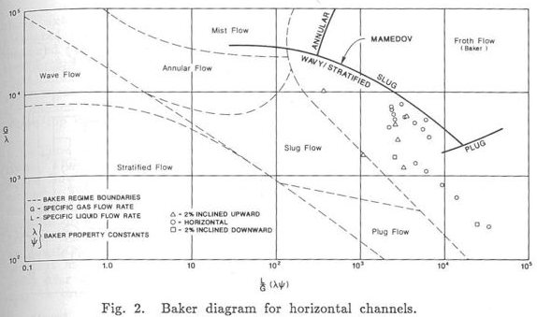
Pressure drop in forced flow (two phase)
Because of low heat of vaporization, single phase LHe flow in a
long pipe can quickly become two phase from a heat in-flow to the pipe.
q
LHe
How to estimate the pressure drop in two-phase helium flow?
Baker plots are used for two phase calculations of oil + gas, air + water flows.
Work of Theilacker and Rode (1988) showed that Baker plot is not suitable for representing helium two-phase flows.
Use Lockhart-Martinelli type approach (next slide).
J. C. Theilacker and C. H. Rode, An Investigation into Flow Regimes for Two-phase Helium Flow, Adv. Cryo. Eng. 33, 391, 1988.

Slide 18
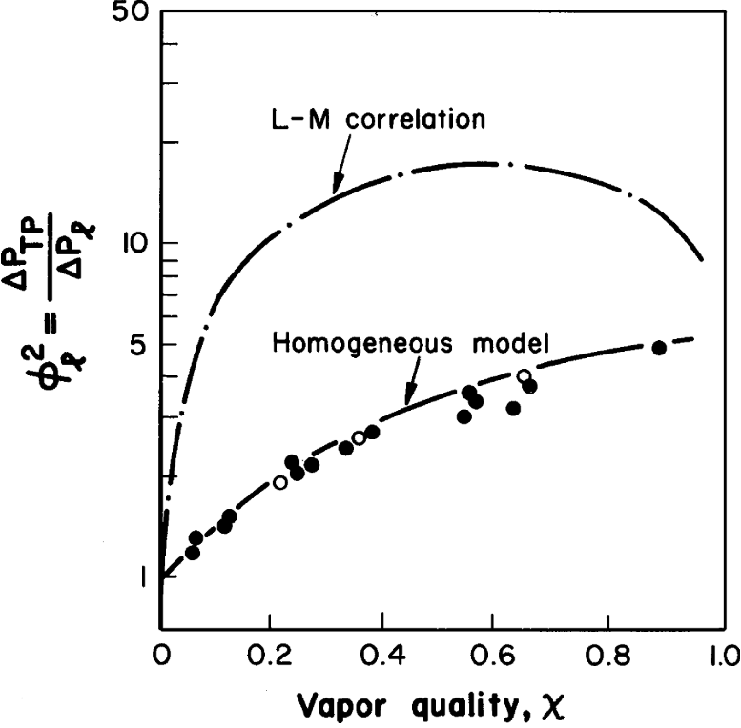
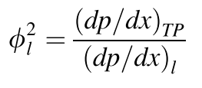
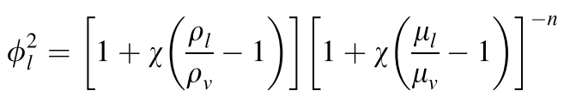
Pressure drop in forced flow (two phase)
A few experiments have found that the Lockhart-Martinelli type approach with homogenous flow model shows reasonable agreement with data.
S. W. Van Sciver, Helium Cryogenics (2012), pg. 104
1) Calculate liquid-phase pressure drop
using appropriate
single phase correlation
2) Calculate homogenous model
two-phase multiplier
3) Calculate two-phase pressure drop

Slide 19
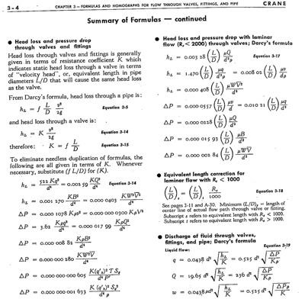
Pressure drop in channels with valves, bends, fittings, etc.
Working expressions
are available in literature
such as Crane Technical paper #410

Slide 20


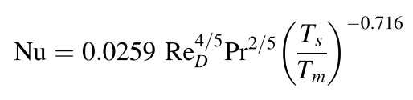
Convective heat transfer
Internal forced flow of normal helium (single phase)
For single phase forced flow of helium (liquid, supercritical),
traditional engineering correlations are best at describing the
experimental data.
for fully developed laminar flow
(rarely seen in practice)
Dittus-Boelter average Nusselt
number for fully developed turbulent
flow
local Nusselt number for
fully developed turbulent flow,
accounting for variation in wall
and fluid temperatures

Slide 21

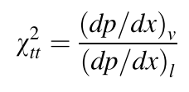
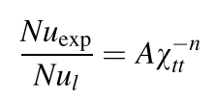
Convective heat transfer
Internal forced flow of normal helium (two-phase)
For two phase forced flow of helium, Lockhart Martinelli type
correlations are shown to work. But experimental data is limited
and so, the correlations cannot be generalized over systems.
Calculate Nusselt number in liquid phase
Calculate pressure drops in the
two phases, the ratio gives the
LM parameter
Two-phase Nusselt number
correlation (general form)
Note: Vapor quality must be known for estimating two-phase Nu

Slide 22
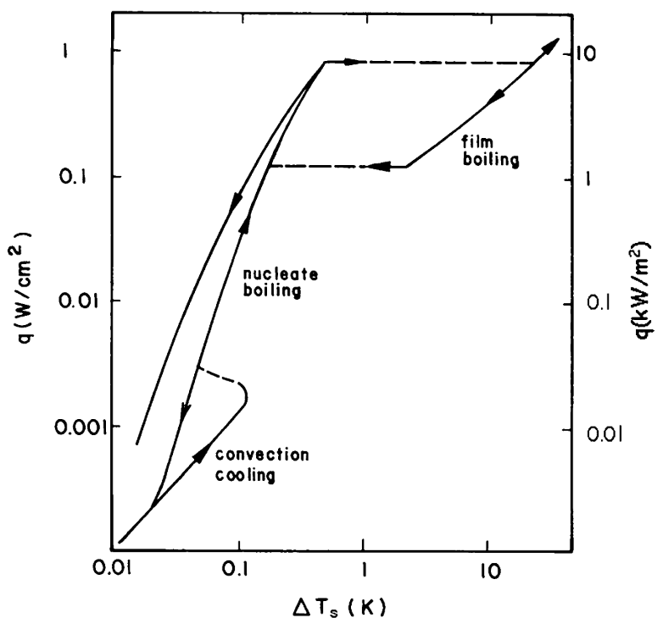
Convective heat transfer
Pool boiling in normal liquid helium
The normal He pool boiling
curve is like that
for conventional liquids
Convection
Nucleate boiling
Film boiling
Recovery with hysteresis
Transition to film
Boiling (CHF, q*)
Recovery from
film boiling
Onset of nucleate
boiling
Transition heat fluxes and the associated superheats are small
Onset nucleate boiling: ~0.1 K, ~1e-3 W/cm²
Transition to film boiling: ~1 K, q* ~1 W/cm²
Recovery from film boiling: ~0.1 W/cm²
(~ten-fold smaller than CHF)
S. W. Van Sciver, Helium Cryogenics (2012), pg. 118

Slide 23
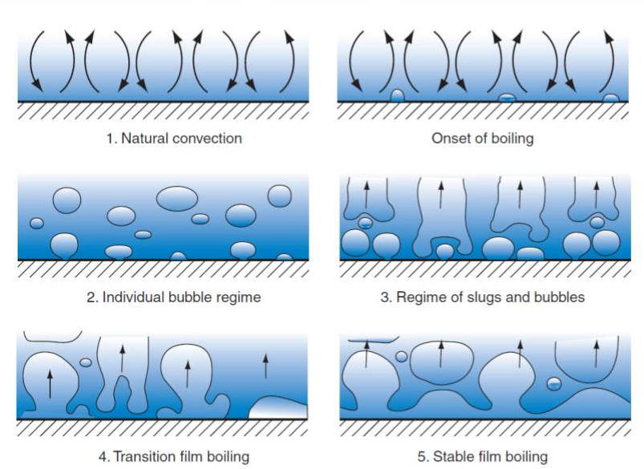
Convective heat transfer
C. J. Geankoplis, Transport Processes and Separation Process Principles (2003), pg. 627

Slide 24
Convective heat transfer
Normal helium pool boiling data and correlations
Boiling Heat Transfer for Oxygen, Nitrogen, Hydrogen, and Helium,
by E.G. Brentari, et al, NBS Technical Note 317, Boulder, CO, 1965.

Slide 25
Other cryogens
Nitrogen and argon are other commonly used cryogens in large scale systems
Liquid nitrogen is commonly used to cool 75-80 K thermal radiation shields around helium baths/pipes
Liquid argon is used in time projection chamber (eg. neutrino detector in Fermilab DUNE)
Since both nitrogen and argon are normal fluids, most pressure drop and heat transfer correlations discussed earlier apply respectively to their flow and heat transfer modes.

Slide 26
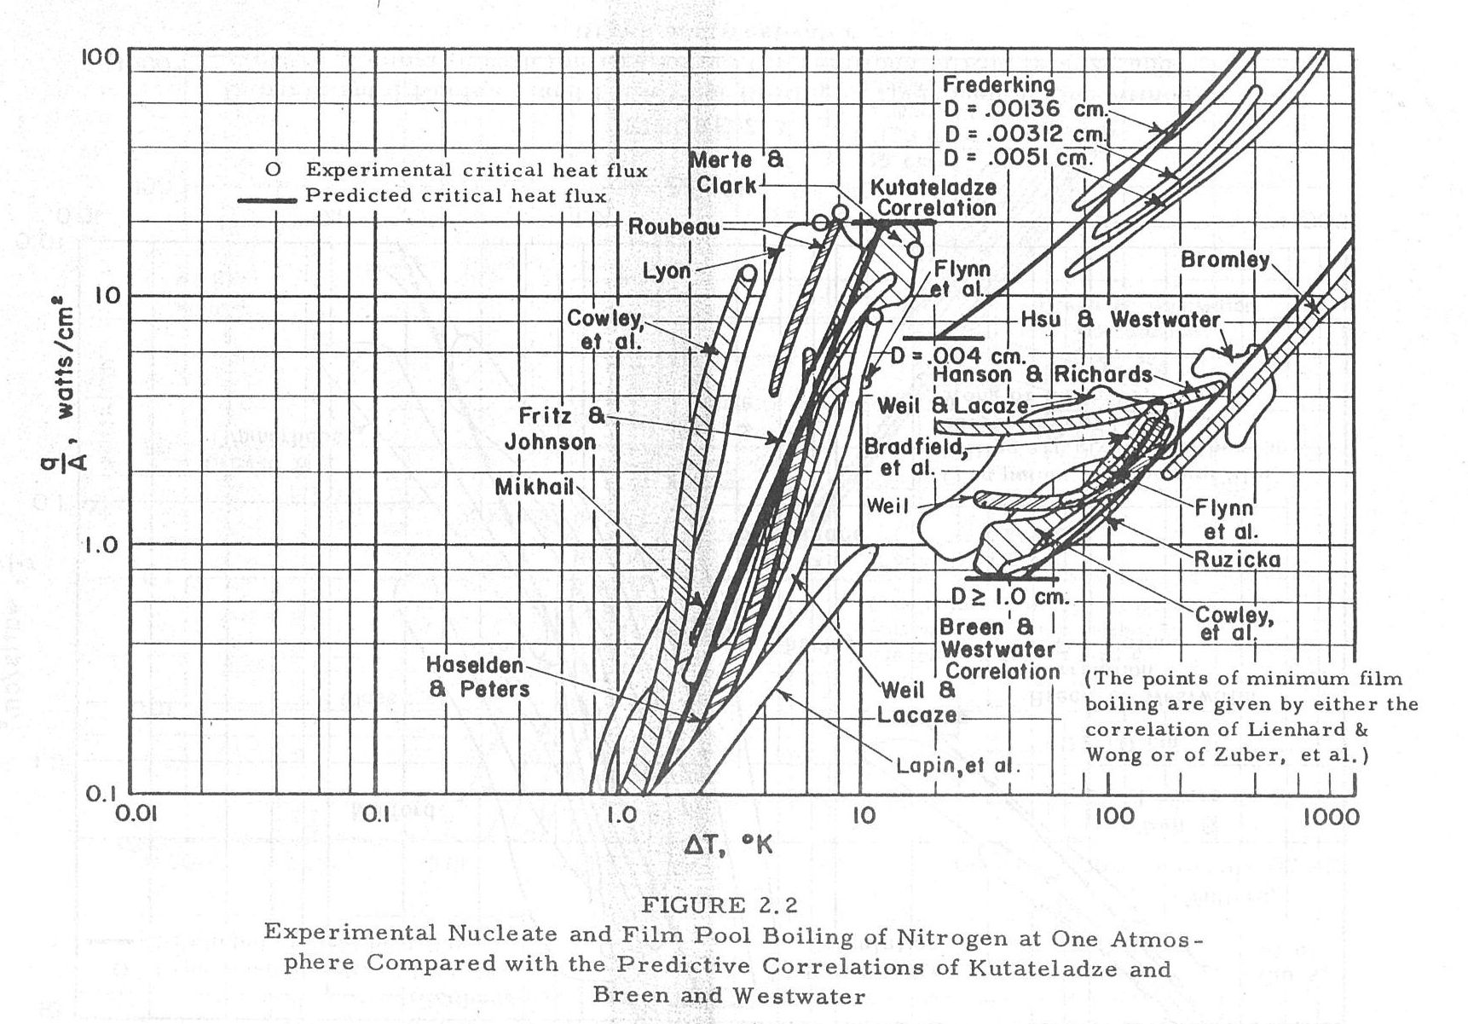
Nitrogen pool boiling data and correlations

Slide 27
References and further reading
S. W. Van Sciver, “Helium Cryogenics,” Plenum Press, 1986.
Ovid Baker, "Design of Pipelines for the Simultaneous Flow of Oil and Gas," Oil and Gas Journal (July 26, 1954) p. 185-195.
J. C. Theilacker and C. H. Rode, “An Investigation into Flow Regimes for Two-phase Helium Flow,” Advances in Cryogenic Engineering, Vol. 33, pp. 391-398, 1988.
E.G. Brentari, et al, “Boiling Heat Transfer for Oxygen, Nitrogen, Hydrogen, and Helium,” NBS Technical Note 317, Boulder, CO, 1965.
Crane Technical Paper #410 “Flow of Fluids through Valves, Fittings, and Pipes”.

